Slide 1
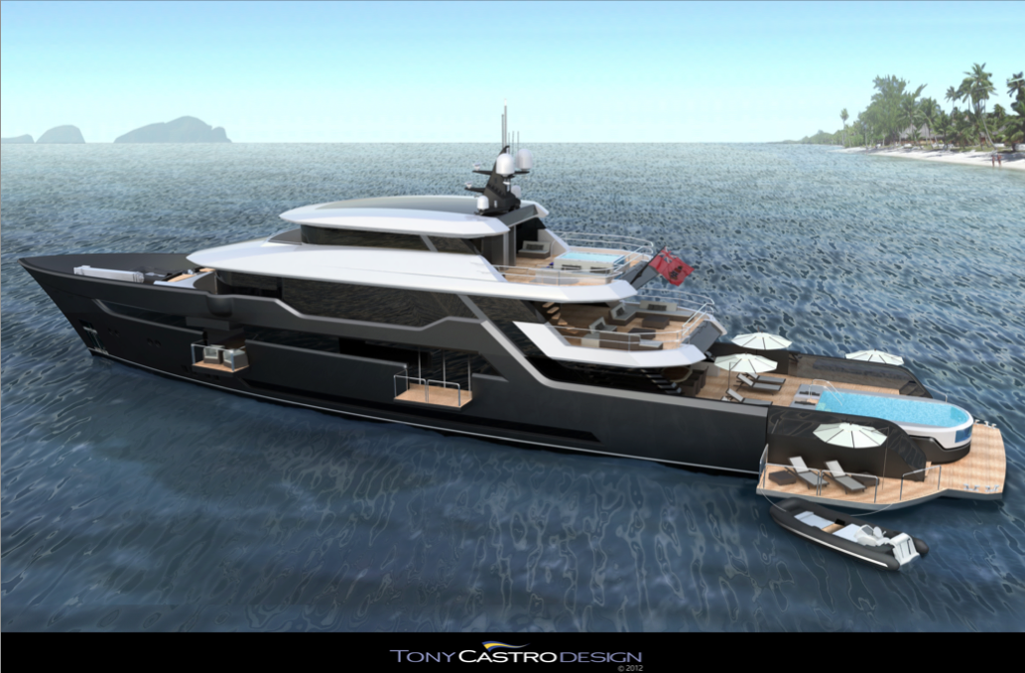
www.bilgin-shipyard.com
VOYAGER 170’
LOA 52m
BEAM 9,10m
DRAFT 2,10m
SPEED 14 Knots Cruising
17 Knots Max
RANGE 6 000 NM
CONSUMP. 179 L/H at 14 Knots
HULL Steel
EXT. DESIGN Tony Castro
INT. DESIGN Tony Castro
CABINS 6 for 12 Guests
CREW 11
DELIVERY 18 Months after signature
PRICE: € 17,500,000
Contact : Jeremy Bottau / jb@bilgin-shipyard.com / 0033 620 146 698

Slide 2
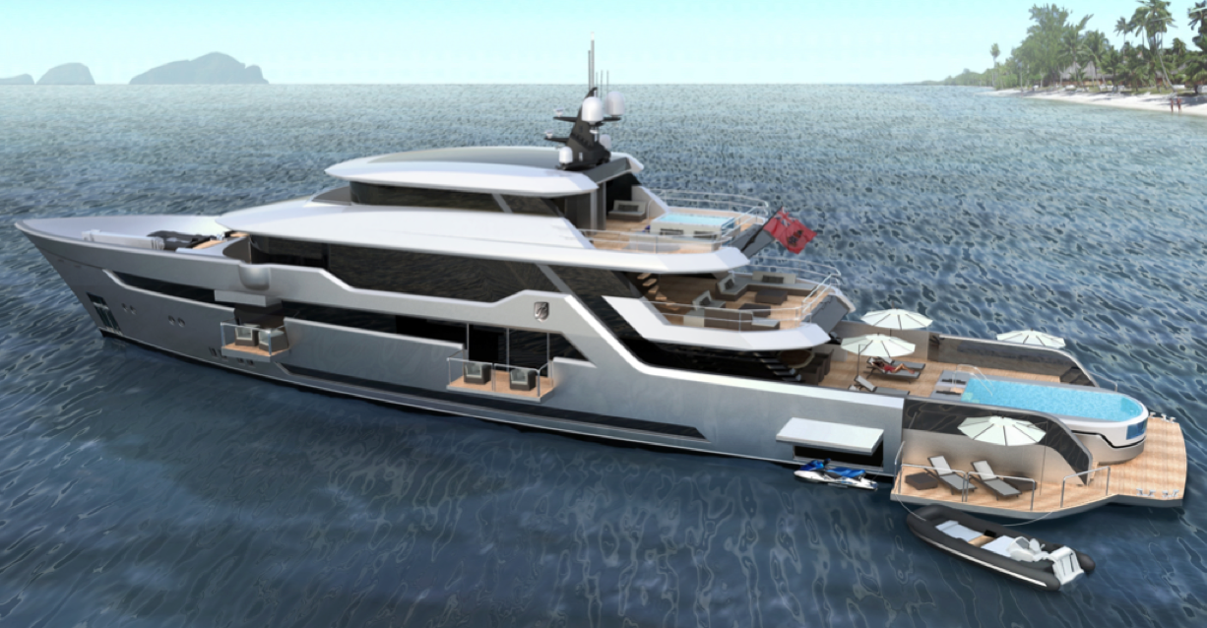
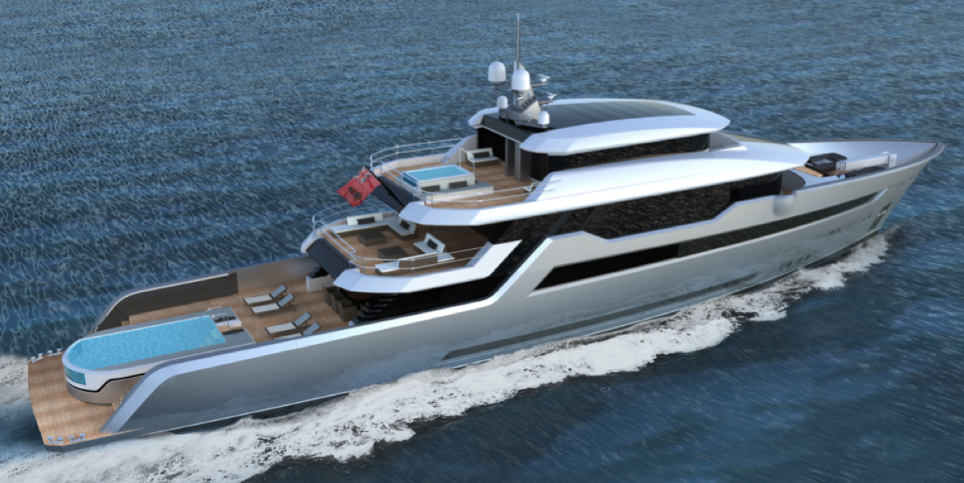
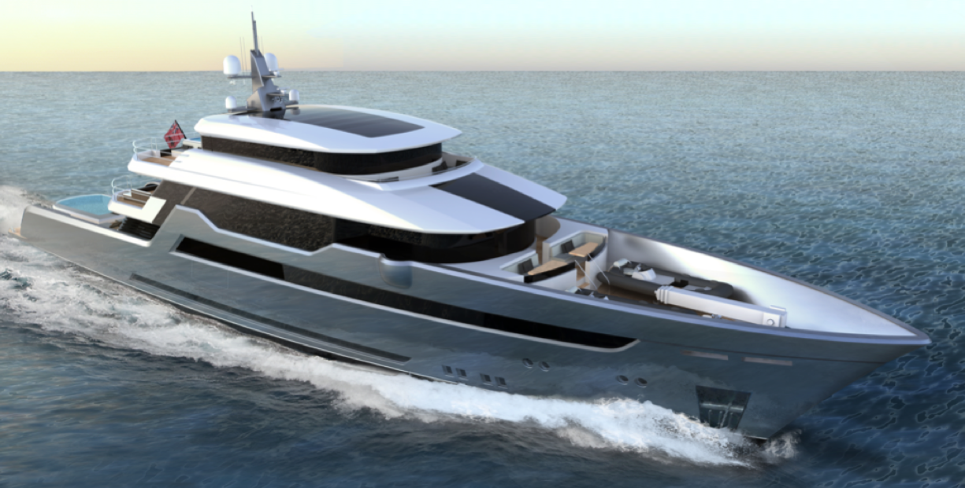
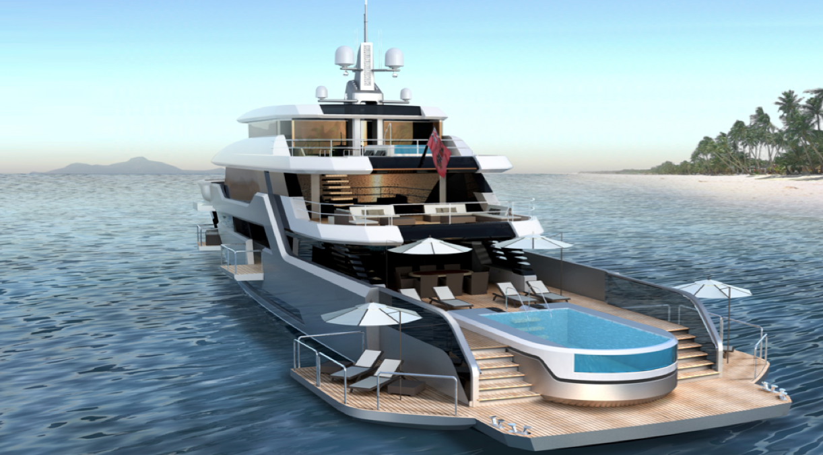
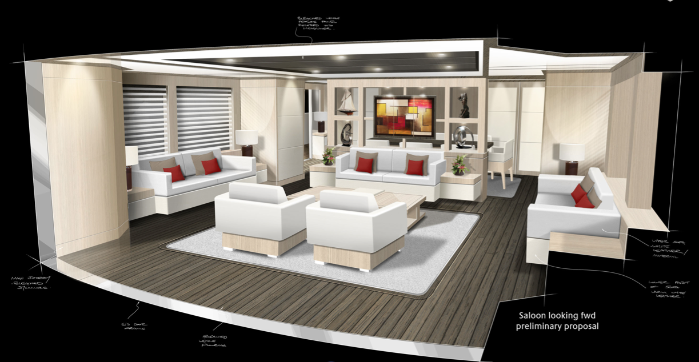
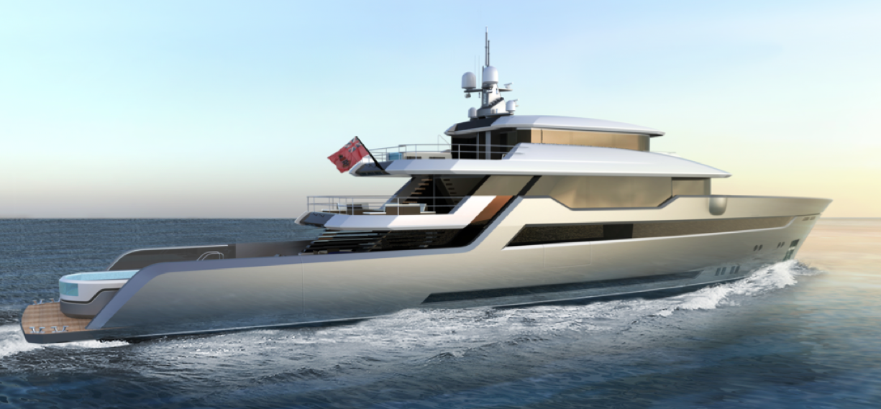
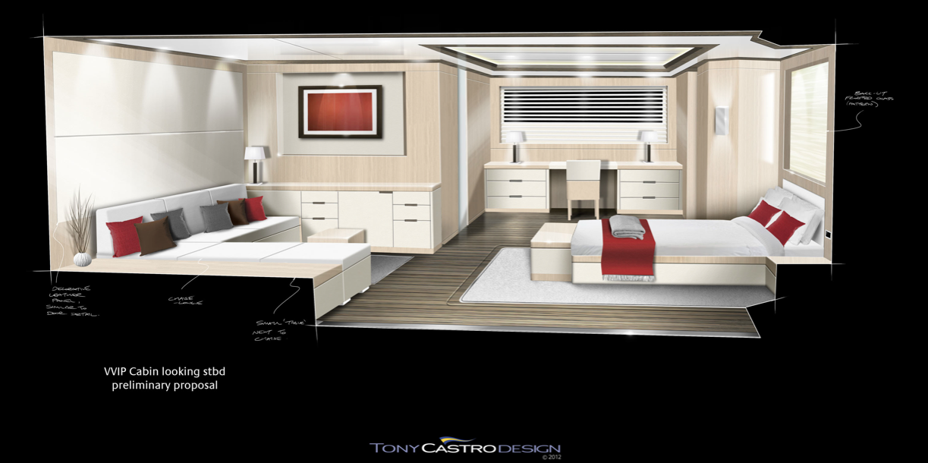
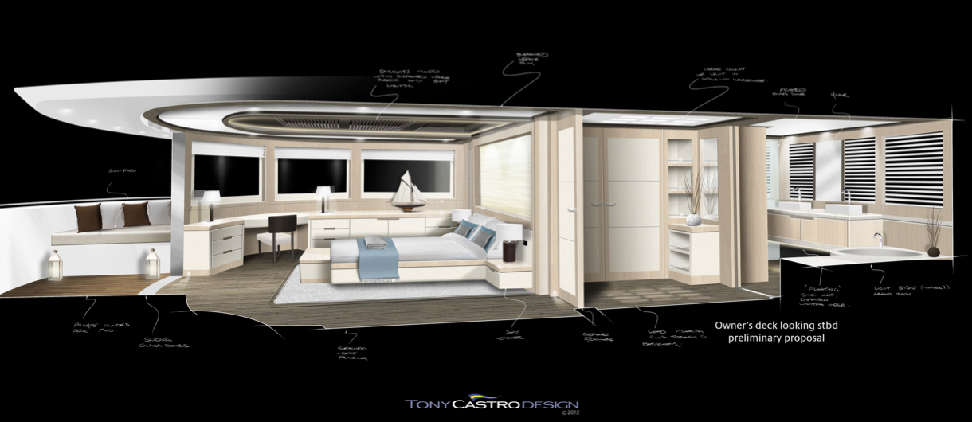
www.bilgin-shipyard.com
Contact : Jeremy Bottau / jb@bilgin-shipyard.com / 0033 620 146 698

Slide 3
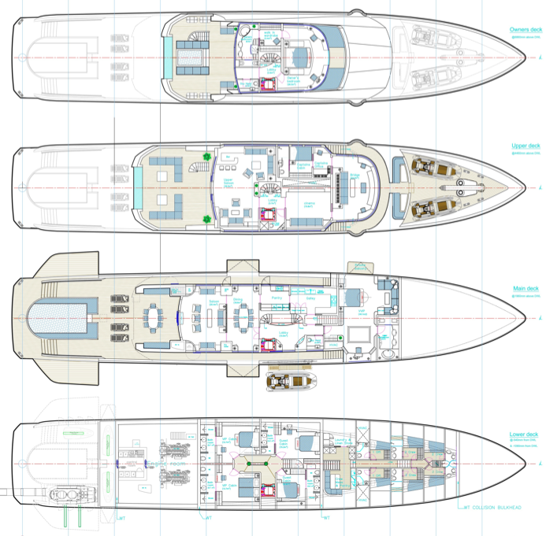
www.bilgin-shipyard.com
Contact : Jeremy Bottau / jb@bilgin-shipyard.com / 0033 620 146 698

